Slide 1
Mobile App to Analyse APK file based on Yara Rule
BITU 3973 Final Year Project I
Muhammad Izham Bin Norhamadi (B032020039)

Slide 2
Introduction
Android Operating System is one of the most popular and widely used open-source mobile platforms and has the highest mobile market share until this day, making it one of the most widely used operating system in the world. This makes Android users the biggest target group for malware developers as trend analyses show large increase in mobile malware targeting the Android platform which leads to privacy thefts of Android users.
Thus, various mobile malware detection systems and tools are proposed in the recent years to address this issue, such as Yara rule

Slide 3
Project Objective
To investigate YARA Rule and its application on malware investigation
To develop a suitable YARA Rule mobile app
To assess developed mobile app using sample APKs

Slide 4
Malware Analysis
Malware analysis is the process of determining the purpose and functionality of a given malware sample and determining its type such as a virus, Trojan horse, or ransomware. This process is a necessary step to be able to develop effective detection techniques for malicious code and its removal from an infected machine. Analyzing the program by inspecting it refers to as static analysis, while analyzing a program during execution is called dynamic analysis.

Slide 5
Yara Rule in Malware Analysis
YARA rules discover malware based on a string-matching technique which can be customized depending on specific requirements to uncover security threats
It achieves this by creating descriptions of malware families based on textual or binary patterns
YARA rule conditions are Boolean expressions which are mostly focused on the binary outcome of the malware analysis
Both quality and quantity of rules are crucial for an effective malware analysis
Due to how flexible and customizable nature YARA rules for malware analysis, there are several YARA rules generator tools that were created to automate the time-intensive process of generating the rules manually such as yarGen, yaraGenerator, and yarbin

Slide 6
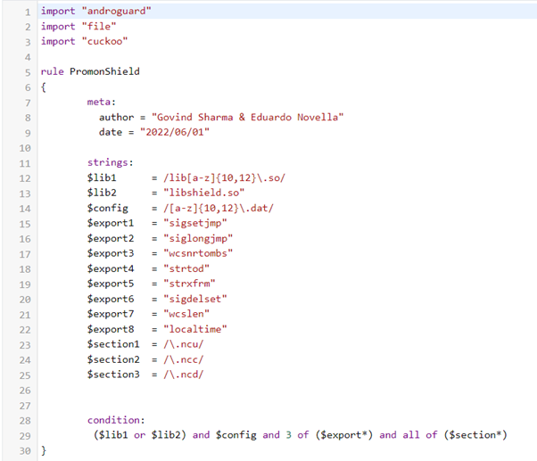
PromonShield Rule on Koodous

Slide 7
Critical Review of Difficulties
Despite YARA being widely accepted technique for malware analysis, few tools exist and relatively little work has been done to automate the generation of YARA rules for specific malware families, many of the automatic generation tools were barely maintained and written with outdated Python libraries. Thus, they were deemed unfit to be implanted to the current project.
Besides that, APKs are zip archives, it is not ideal to build rules using APK information such as manifest and certificate as decompressing zip and extracting the information into a single module would add a lot of unnecessary complexity and dependencies. Most analysts resort to building YARA rules for the dex file only without external help
Koodous platform provides an API to parse the APK file into a JSON report to be used with androguard-yara but the usage limit for analysis report for free user is 5/day which is not ideal

Slide 8
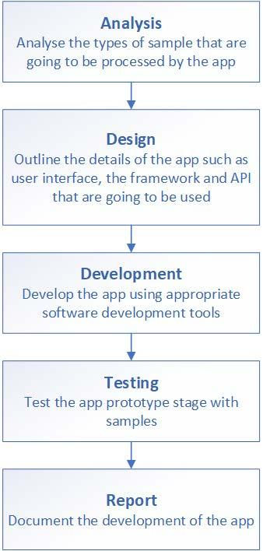
Project Methodology

Slide 9
Flutter Development Framework
Flutter is an open-source framework by Google for building multi-platform applications from a single codebase
Written with Dart Language, compiled with type-safe language (like C# and Java) and scripting language (like Python and JavaScript)

Slide 10
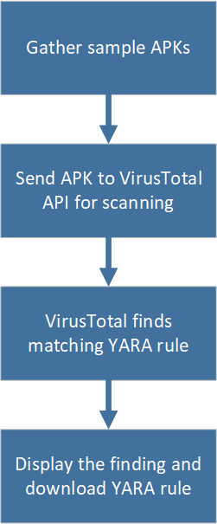
Yara Generation Phases

Slide 11
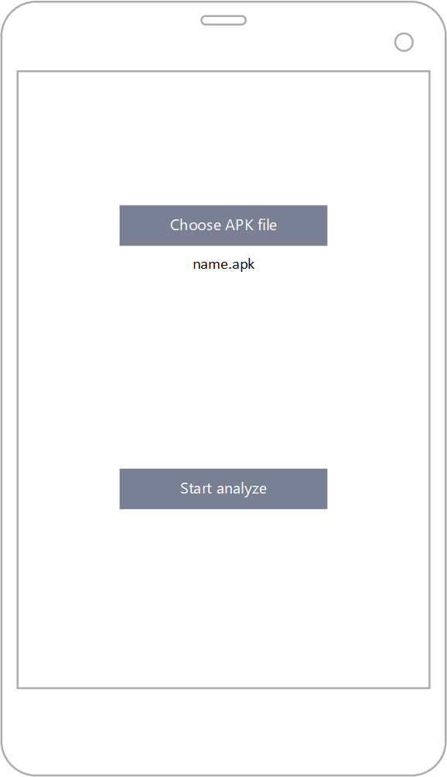
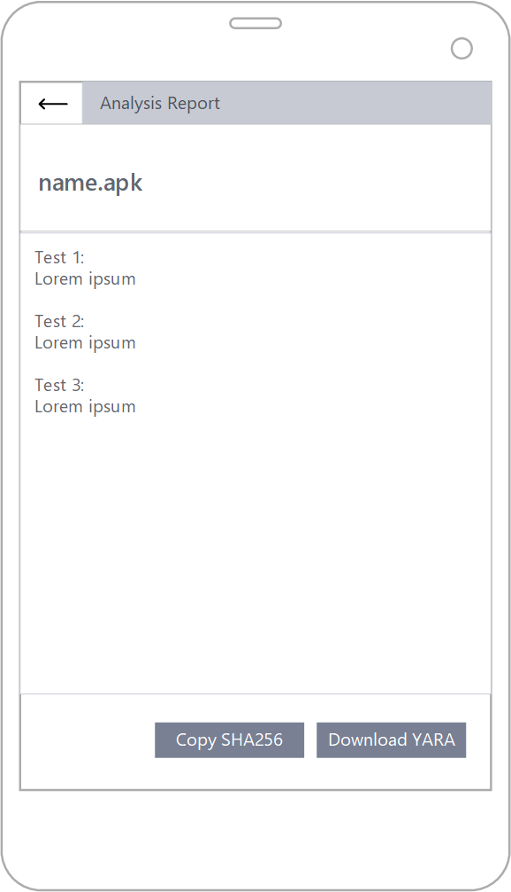
App Design

Slide 12
Live Demo

